Slide 1
BLIND HUMAN EMOTION RECOGNITION AND PATTERN CLASSIFICATION ALGORITHM TO IDENTIFY VISION IMPAIRED LEARNER
17-111

Slide 2
GROUP DETAILS Group No – 17-111
SUPERVISOR | Dr.Pradeepa Samarasinghe
CO-SUPERVISOR | Mr.Anuradha Jayakody
IT Number | Name
IT13235734 | A.S.M Mendis
IT13148164 | S.K.K.K..L Chandrasekara
IT13048310 | S.L Warusavitharana
IT13139254 | H.A.D Ruchira

Slide 3
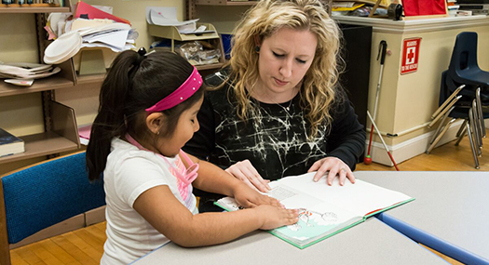
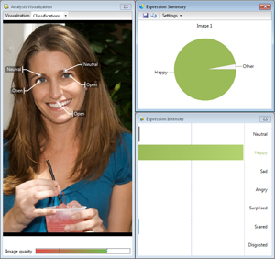
BHER EMOTION AI HUMANIZES HOW PEOPLE AND TECHNOLOGY INTERACT
Our focus is to identify Blind students emotions in learning context and get them motivate in learning as normal students.

Slide 4
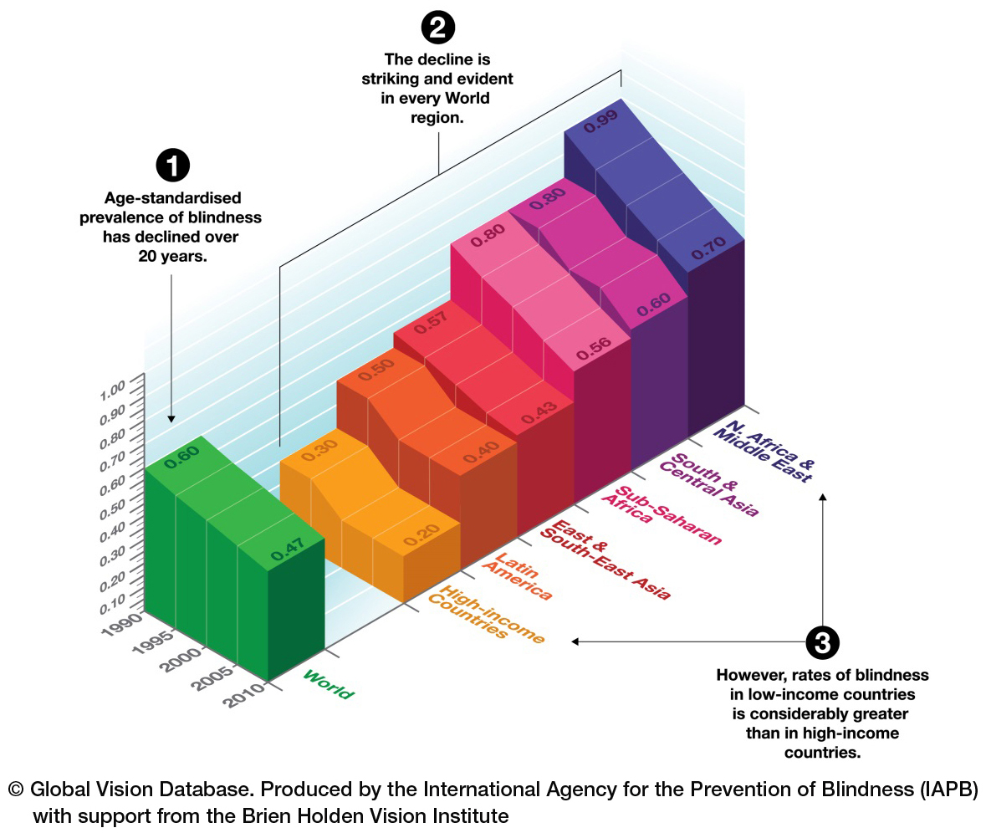
Background
285 million people are estimated to be visually impaired worldwide, 39 million are blind and 246 have low vision and in Sri Lanka according to Department of Census and Statistics 69096 are visually impaired.
They are also keen on learning nowadays. So without neglecting them We have to motivate them in studies as normal students.

Slide 5
Assistive Technologies
People who are blind are completely not able to interact with the computer without assistive technologies.
printed brail lecture notes.
tactile graphics to identify pictures, maps, graphs, diagrams.
screen reader software speaks all the information in a human voice which comes on the screen as well as the text which is typed on the keyboard

Slide 6
RESEARCH PROBLEM
Blind students deal with many of the same emotions normal students do. They get angry, sad, frustrated, nervous, happy, or embarrassed.
Though in a regular classroom it’s difficult for the tutor to identify blind student’s comprehension based on facial expressions as we cannot get eye expressions.

Slide 7
OBJECTIVES
Identify blind student’s emotion in current moment by analyzing facial expressions of webcam detected image.
Get emotions based on students behavioral patterns using keystroke dynamics.
Identify blind student’s physical, mental condition in class room from the performance of mouse movements.
Analyze emotions and predict best solution to motivate, provide voice notification when their attention is low, Adaptive content delivery.

Slide 8
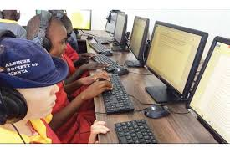







Slide 9
UNIQUENESS
Application | Blind emotion recognition | Intelligent tutoring and content delivery | Student interactive motivational options | Giving voice notifications
Lugram | ✗ | ✓ | ✗ | ✓
JAWS | ✗ | ✗ | ✓ | ✗
anMasterMind | ✗ | ✓ | ✗ | ✓
eyeris | ✗ | ✗ | ✗ | ✓
emospeech | ✓ | ✗ | ✗ | ✗
BHER | ✓ | ✓ | ✓ | ✓

Slide 10
Blind face detection and emotion recognition
Facial expressions give important clues about emotions
We are going to develop a new optimization algorithm for blind facial expression recognition which can classify the given image into one of the seven basic facial expression categories (happiness, sadness, fear, surprise, anger, disgust and neutral).

Slide 11
RELATED WORK Blind face detection and emotion recognition
several methods have been proposed to classify emotions.
Mase proposed emotion recognition systems that use directions of facial muscles.
Hyeon Bae, Sungshin Kim proposed a real time face detection and recognition.
Ankit Goswami and Ahutosh Datar proposed face detection and recognition using skin pixels.
Ekman proposed geometric model.
M. Karthigayan proposed a method that extracts region of eye and lip by genetic algorithm.

Slide 12
METHODOLOGY
Research Area – Image processing , ANN
We are going to implemented a program that uses a webcam to capture your face and determine emotions. We use openCV computer vision library to preprocess the webcam image.
Firstly a series of pre- processing tasks such as adjusting contrast, filtering, skin color segmentation and edge detection will be done. In order to extract features. To extract features we will use high speed projection profile.
Then features will be given as input to the PSO to compute the optimized values.
And will use logistic regression algorithm and ANN to train on a provided dataset and evaluate the emotion.

Slide 13
MOUSE MOVEMENT
Even though mouse movement is something differ from routine of visually impaired people we are determined to take that details because nowadays they also use mouse as sighted people.
There are many researches based on mouse movement dynamics and also based on visually impaired people but no research in tracking and identifying emotions of visually impaired people based on mouse movement.
A tactile mouse made by Tactile World company, is one of input device which is made for visually impaired people but there is no way to recognize how they feel when they are using these equipment.

Slide 14
RELATED Work
Biometric Mouse Intelligent System for Student's Emotional and Examination Process Analysis - Arturas Kaklauskas; Mindaugas Krutinis; Mark Seniut
Detecting cognitive stress from keyboard and mouse dynamics during mental arithmetic - Yee Mei Lim; Aladdin Ayesh; Martin Stacey
User re-authentication via mouse movements - Pusara, M.; Brodley
Inferring negative emotion from mouse cursor movements - Hibbeln M, Jenkins JL, Schneider C, et al

Slide 15
Research AREA
Data mining – when we identify emotions based on user replies we can use the details to identify their emotion when they use computer with any interruption
Data Analytics – gathered replies and mouse movement data should analyze and identify the pattern and label the emotion
Methodology and Technology
globalmousekeyhook package
Add some simple Q&A application to identify emotions of user
Gather data through that application
Mouse speed
Time between pressing & releasing mouse button
No of mouse clicks
No of pauses etc.
Calculate the minimum, maximum and standard deviation from that data
Label the emotions for calculated and analyzed data according to their replies
Analyze and compare normal data and identify the emotion labels for them
Send feedback to user

Slide 16
KEYSTROKE DYNAMICS- RELATED WORK
Mohsen proposed an attendance control system by monitoring student’s behaviors.
Janis proposed key loggers for track user inputs on mobile devices.
Mahamod proposed developed an android application to demonstrate the attack. They used screen dimensions, keyboard layouts and different classification scheme .
Swar proposed to develop a voice recognition system which will be used for controlling computer without from use of mouse or keyboard. They can wear a headset and have their hands.

Slide 17
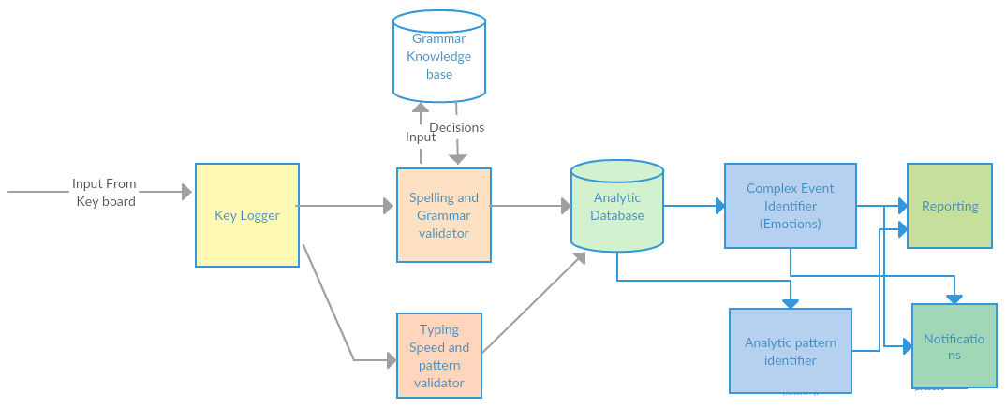
METHODOLOGY
Research area –Data mining ,Data analytics

Slide 18
MOTIVATE RELATED WORK
EDM (Educational Data Mining)[8] is an area of data mining that is developed for address problem of education .Addressing such problem can be lead to Removing or adding material to the unit according to the student feedback. [9]Feedback in education categorized into two categories.
1).feedback from lecturer to student
1).feedback from student to lecturer
Emotins can be negative such as confused, angry, sad. positive Emotions such as confident and happy.
Attributes included on the student model are different for different EDM systems and even for different courses of the same system, and they can include, for example: previous knowledge, language, age, and learning styles, among others. If for a given adaptive course relevant attributes are, for instance, previous knowledge, language and age, the model or profile for a concrete student can contain {“advanced”, “English” and “young”}.

Slide 19
METHODOLOGY
Tutor
Learners
Title, difficulty level and Attachment
Select Topic
Database
Content details
Upload Learning Contents
Capture Student face
Store Contents
Topic
Remote Server
Content details
Deliver the content
System
Monitor Student Emotions
Filter by selected topic and difficulty level
Appropriate content location
Load Content
Student Emotion
Filtered Content
Decision Making (Appropriate or not appropriate)

Slide 20

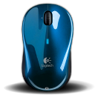

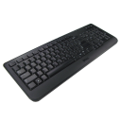




Image Acquisition(webcam image)
Answer questions of our simcple application
Normal work using mouse
Preprocessing
ROI and Histogram Equalization
Track the keys entered in the keyboard
Gather data through their reply and interaction with mouse
Gather data using their normal behaviour
Face Boundary Detection
Check the spelling and grammer
Identify numbers and characters
Analyze students behavior pattern
Analyze data and identify patterns
Cropping the eyebrows, lip, nose, Forehead region
Provide voice notification
Compare the result with the result of feature extraction and keystroke dynamics
Analyze keystroke details
Feature Extraction
Optimize Parameters with the use of new algorithm
Emotion Classification using ANN
Give feedback

Slide 21
Work Break Down Structure
Face detection and emotion recognition
analyze and recognize behavioral patterns
Preprocessing
Emotion classification using neural network
1.Track keys enter in keyboard
2.recognize behavioral patterns of blind students
3.provide analytical report
Detect webcam image
Classification based on eyebows,lips,forehaed features
1.1 Correct the grammar mistakes
2. track changing behavioral patterns in each time
3.1 Detecting emotions by analyzing real time stream of events.
3.2 provide voice notification
ROI & Histogram equalization
Face boundary detection
Train the network
Image processing and feature extraction
Analyze emotions

Slide 22
WORK BREAKDOWN STRUCTURE of mouse movement dynamics
Collection of data when user doing normal work
Collection of data when our dialog-box popup & answered
Identify normal mouse speed
Mouse Movement Dynamics
Time between pressing & releasing
mouse button
No of pauses per fixed time slot
Identify no of mouse clicks within fixed time slot
Identify mouse speed
no of mouse clicks and ignored or missed
Calculate minimum, maximum and standard deviation of the collected data
label the information according to analyzed data
Analyze the data (normal behavior) and identify the emotion abels for them
send the feedback to user

Slide 23
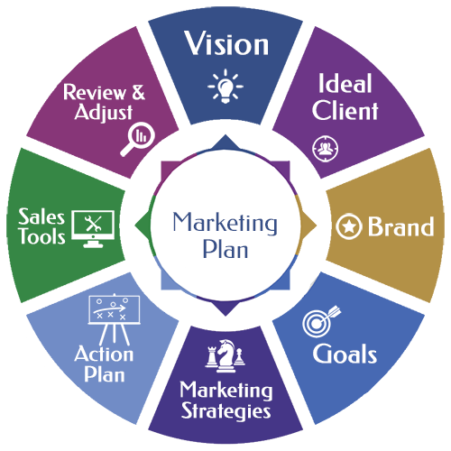
Marketing PLAN
Encourage and make blind students easy in learning as normal students.
In Sri Lanka according to Department of Census and Statistics 69096 are visually impaired. Our target client group is them.
We are going to promote our software through our website.
BHER(Blind Human emotion recognition and pattern identification) free Desktop application to motivate blind students in learning context
Software is given to the user free of charge
It will be easy to use.
1.Understand Customer
2.Analyze market, analyze competition
3.Brand awareness
4.Customer Acquisition
5.Lead Generation
6.Customer Retention/Loyalty
7.Engagement
Website, Social networking, Public relations

Slide 24
Target client group
In Sri Lanka according to Department of Census and Statistics 69096 are visually impaired. Our target client group is them.
For our valuable time and work we are aim to release our software initially at the price of Rs 25,000.
Then we are planning to modify this according to user feedbacks and increase our price with the competence of market prices.
Further we are planning to develop mobile app version from this to gain more Profit.
Commercialization plan

Slide 25
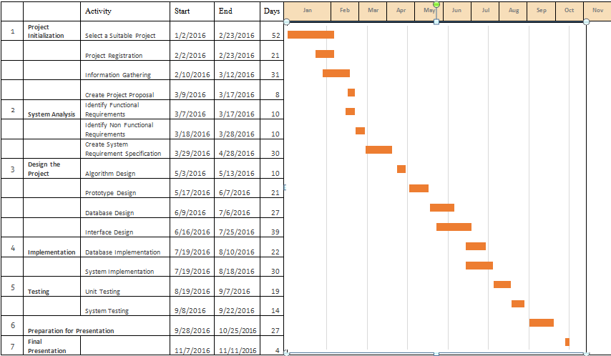

Slide 26
Final Report(Draft) to the supervisor
10/4/2017
Website Assesment
10/28/2017
Feedback submission
10/20/2017
Today
2017
Mar
Apr
May
Jun
Jul
Aug
Sep
Oct
Nov
2017
3/17/2017
Image Acquisition -webcam face detection
4/6/2017 - 4/8/2017
Project Proposal Report
ROI and Histogram Equalization
4/8/2017 - 4/10/2017
11/21/2017
Cropping regions
4/6/2017
Final Document
4/10/2017 - 4/12/2017
Project Proposal Presentation
11/21/2017
Image processing and Feature Extraction
4/12/2017 - 4/15/2017
viva
4/25/2017
8/18/2017
Optimization algorithm for analysing
SRS
Research Paper
4/15/2017 - 4/25/2017
11/21/2017
4/25/2017
6/28/2017
9/7/2017
Final Presentation
Analyze the features
4/25/2017 - 4/30/2017
11/17/2017
Maintain Facial database
Prototype
4/30/2017 - 5/4/2017
Progress Presentation-I
Progress Presntation -II
Final Report(Soft Bound)
Train the inputs using backpropagation algorithm
5/4/2017 - 5/26/2017
3 days
Test the emotions
5/26/2017 - 6/8/2017
3 days
Predict and notify
6/8/2017 - 6/15/2017
3 days
4 days
11 days
6 days
5 days
23 days
14 days
8 days

Slide 27
THANK YOU

